Slide 1

DTCL – Dıstance and tıme controlled lock
Semester II (2021-2022)
Embedded Systems Course
Final Project Presentation
Course Code: CPE316
Supervisors: Dr. Iman Elawady ; ENG. Michael B.Khani
*Muhammet Özer (2017010206037@ogrenci.karabuk.edu.tr)
Adem Onur Çelik (1910205022@ogrenci.karabuk.edu.tr)
Hatice Gül Çoban (1810205036)(haticegcobann@hotmail.com)
Feride Nur Yaman (1810205069@ogrenci.karabuk.edu.tr)
Ayfer Gözel (2017010216013@ogrenci.karabuk.edu.tr)
Bayram Enes Yıldırım (2017010206020@ogrenci.karabuk.edu.tr)
İrem Yargı (1910206527@ogrenci.karabuk.edu.tr)
Ahmet Köşker (2017010206022@ogrenci.karabuk.edu.tr)
1
* Team leader and correspondent member

Slide 2

Contents
Introduction
Objectives
Conclusion
Project Design
References
Related Works
Application
Goals
Summary
Software
Hardware
Challenges
Results
Future works (Optional)
2

Slide 3
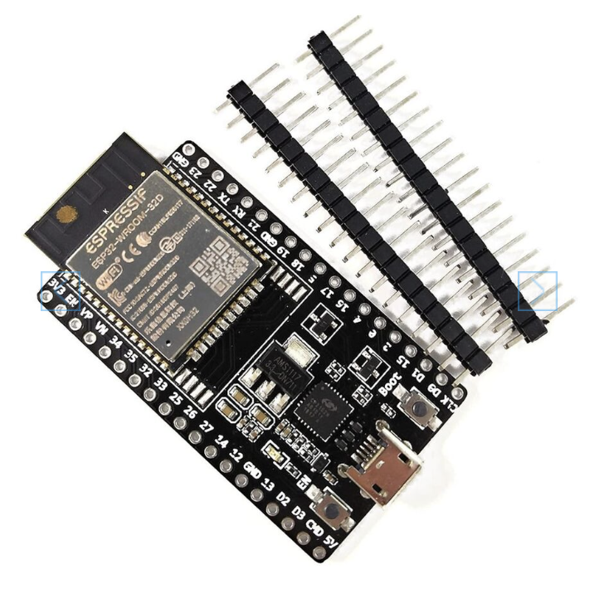
Introduction
Summary
We can choose which pins on the ESP32 are UART, I2C, or SPI by setting them in
the code. We’ve used I2C LCD, HCSR04 distance sensor, and servo motor.
This is feasible because to the multiplexing capability of the ESP32 chip, which allows many functions to be assigned to the single pin.
3

Slide 4
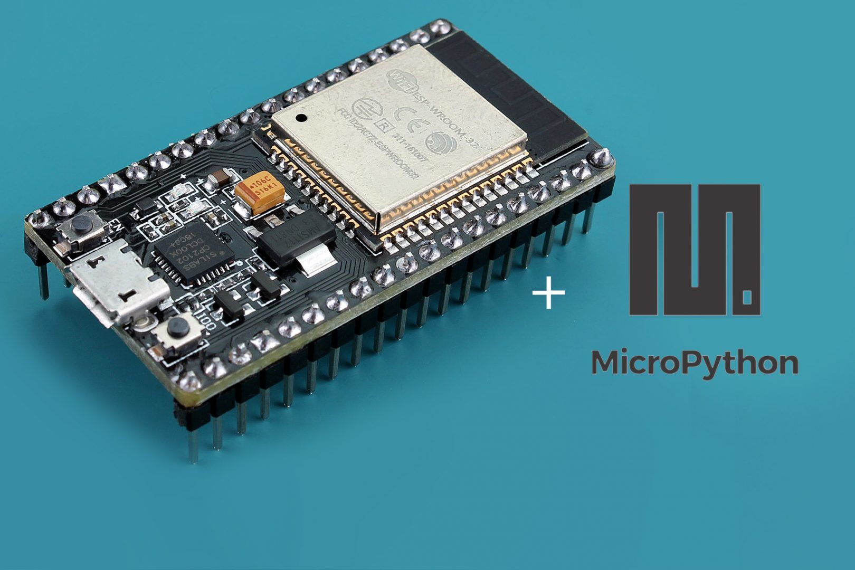
Introduction
Goals
Main purpose of DTCL is to provide home security by controlling locks. These locks can be used with windows, drawers, doors etc.
When activated if someone is at home or time is before midnight all locks are unlocked. If someone isn’t home or time is after midnight all locks are locked. But what if we want to use them after midnight? Distance sensor will be remained active and let you unlock if you’re closer than 40 centimeters.
4

Slide 5
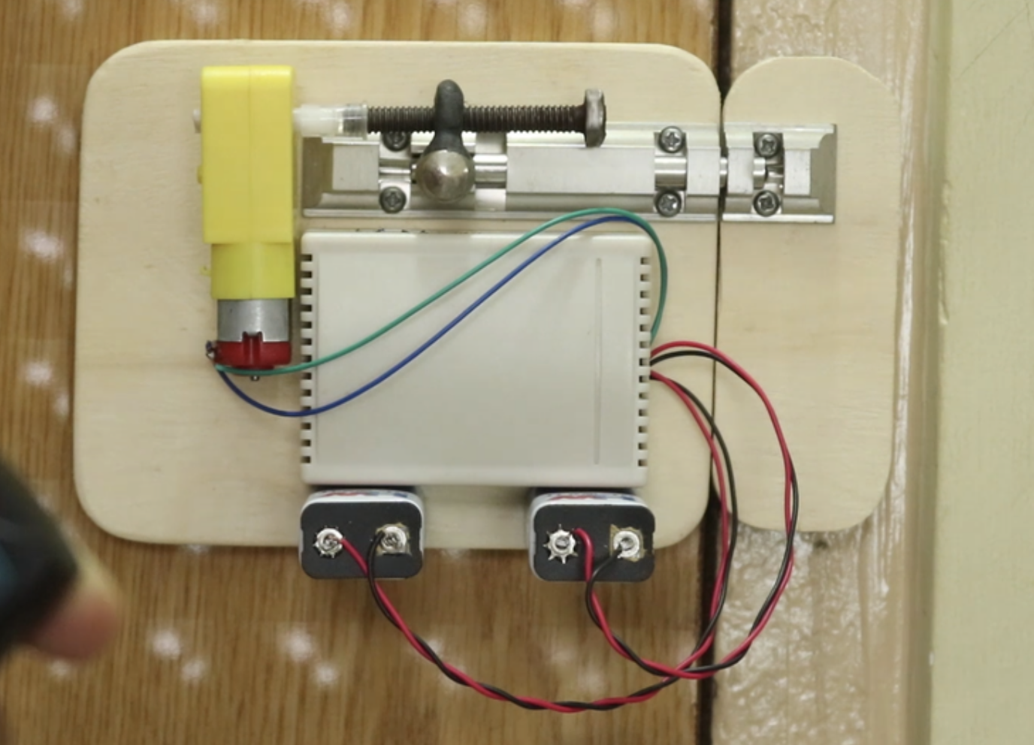

Slide 6
Related Works
We can choose which pins on the ESP32 are UART, I2C, or SPI by setting them in
the code. We’ve used I2C LCD, HCSR04 distance sensor, and servo motor.
This is feasible because to the multiplexing capability of the ESP32 chip, which
allows many functions to be assigned to the single pin.
6

Slide 7
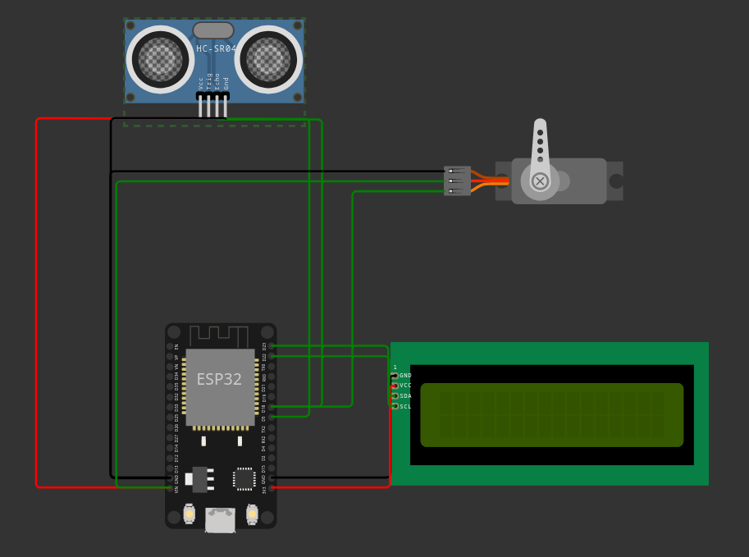
PROJECT
7

Slide 8

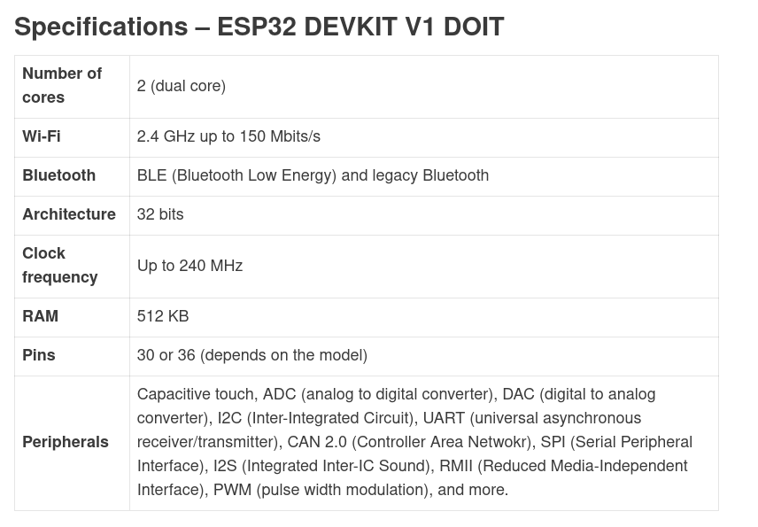
Project Design
8

Slide 9
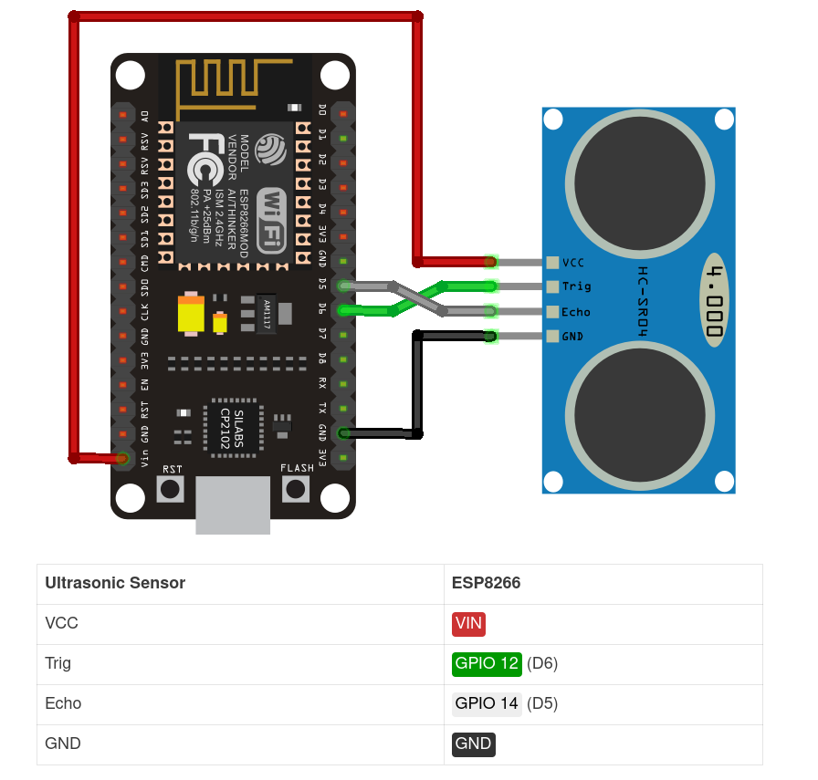
Hcsr04
9

Slide 10
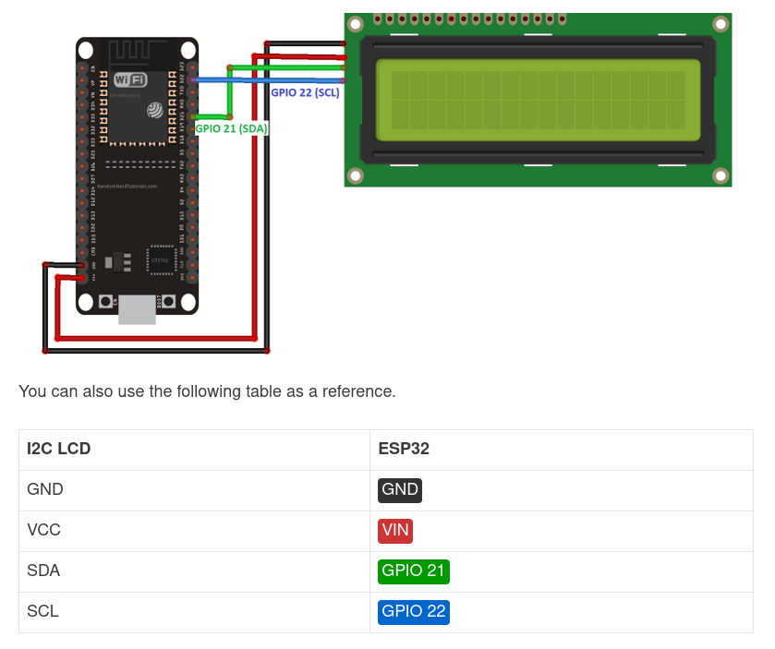
I2C LCD
10

Slide 11
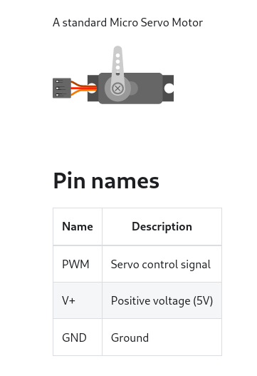
SERVO
11

Slide 12
MAIN.PY 1
import machine from machine import Pin, SoftI2C,PWM from lcd_api import LcdApi from i2c_lcd import I2cLcd from time import sleep from hcsr04 import HCSR04 # I2C LCD sensor and parameters I2C_ADDR = 0x27 totalRows = 2 totalColumns = 16 i2c = SoftI2C(scl=Pin(23), sda=Pin(22), freq=5000) #initializing the I2C method for ESP32 lcd = I2cLcd(i2c, I2C_ADDR, totalRows, totalColumns) lcd.putstr("WELCOME") sleep(2) lcd.clear() lcd.putstr("Project LAMBDA") sleep(2) lcd.clear() # HCSR04 Sensor and parameters sensor = HCSR04(trigger_pin=5, echo_pin=18, echo_timeout_us=10000) servo = PWM (Pin(18), freq=50)
12

Slide 13
MAIN.PY 2
start = time.time() while True: distance = sensor.distance_cm() sleep(1) servo.duty(1) lcd.clear() end = time.time() sleep(1) if (distance<40): lcd.putstr("Lock enabled.") sleep(2) lcd.clear() servo.duty(90) elif((end - start) > 100): lcd.putstr("Lock enabled.") sleep(2) lcd.clear() servo.duty(90) end = 0 else: lcd.putstr("Lock disabled.") sleep(2) servo.duty(1)
13

Slide 14
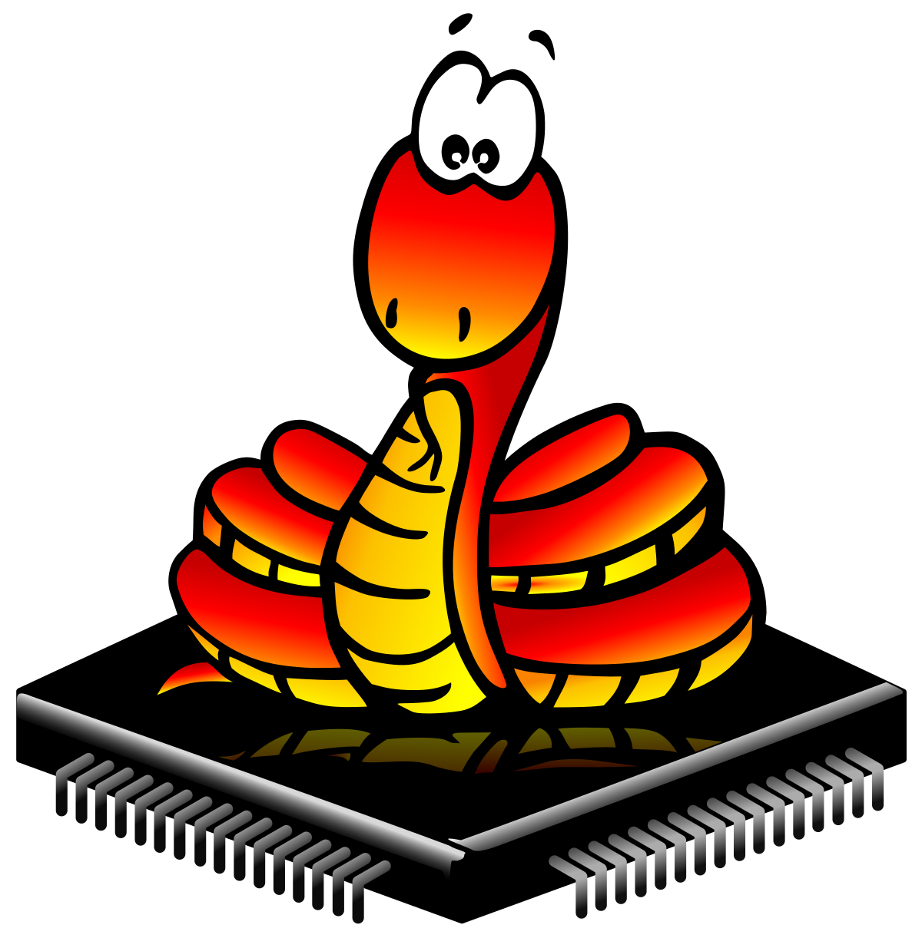
Conclusion
For the first time in a project, we had used micropython. We spoke about the
issues and figured out how to solve them. We tried to work together.
14

Slide 15
References
IEEE Referencing standard, i.e.:
Hasani, R., Lechner, M., Amini, A., Rus, D., & Grosu, R. (2020). Liquid time-constant networks. arXiv preprint arXiv:2006.04439.
15

Slide 16
THANKS FOR LISTENING!
ANY QUESTIONS? :)
16

